Slide 1
Planning by Dynamic Programming

Slide 2
Outline
Dynamic Programming
Policy Evaluation
Policy Iteration
Value Iteration

Slide 3
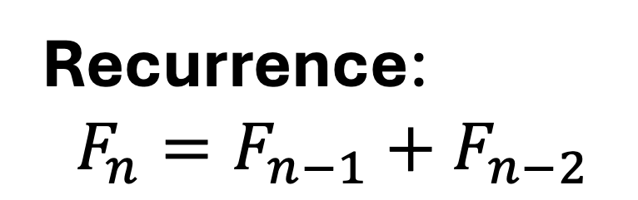
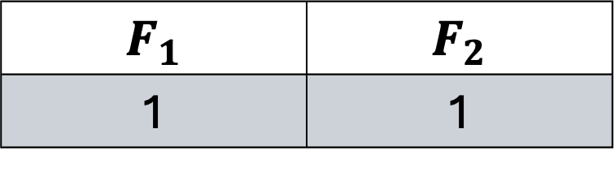
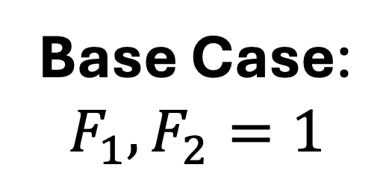
Fibonacci Sequence
$$F_{1}$$ | $$F_{2}$$
1 | 1
Base Case:
$$F_{1}, F_{2}=1$$
Recurrence:
$$F_{n}=F_{n−1}+F_{n−2}$$

Slide 4
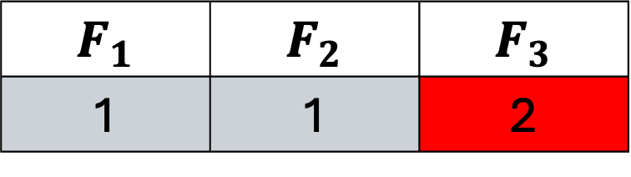
Fibonacci Sequence
$$F_{1}$$ | $$F_{2}$$ | $$F_{3}$$
1 | 1 | 2
Base Case:
$$F_{1}, F_{2}=1$$
Recurrence:
$$F_{n}=F_{n−1}+F_{n−2}$$

Slide 5
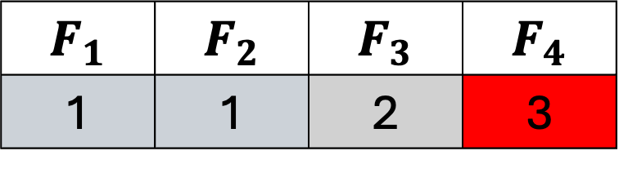
Fibonacci Sequence
$$F_{1}$$ | $$F_{2}$$ | $$F_{3}$$ | $$F_{4}$$
1 | 1 | 2 | 3
Base Case:
$$F_{1}, F_{2}=1$$
Recurrence:
$$F_{n}=F_{n−1}+F_{n−2}$$

Slide 6
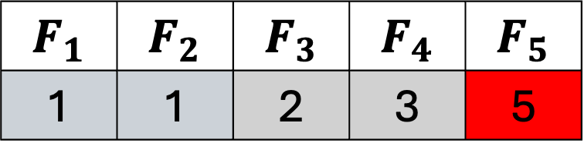
Fibonacci Sequence
$$F_{1}$$ | $$F_{2}$$ | $$F_{3}$$ | $$F_{4}$$ | $$F_{5}$$
1 | 1 | 2 | 3 | 5
Base Case:
$$F_{1}, F_{2}=1$$
Recurrence:
$$F_{n}=F_{n−1}+F_{n−2}$$

Slide 7
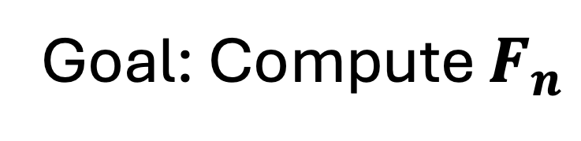
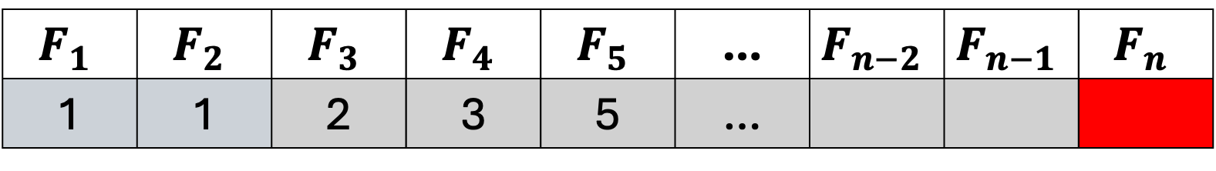
Fibonacci Sequence
$$F_{1}$$ | $$F_{2}$$ | $$F_{3}$$ | $$F_{4}$$ | $$F_{5}$$ | … | $$F_{n−2}$$ | $$F_{n−1}$$ | $$F_{n}$$
1 | 1 | 2 | 3 | 5 | …
Goal: Compute $F_{n}$

Slide 8
Fibonacci Sequence: Naïve Solution
def fib(n):
if n <= 2:
f = 1
else:
f = fib(n-1) + fib(n-2)
return n
Does the Algorithm work?
Yes!
Is it a good algorithm?
No!
Exponential Time!!

Slide 9
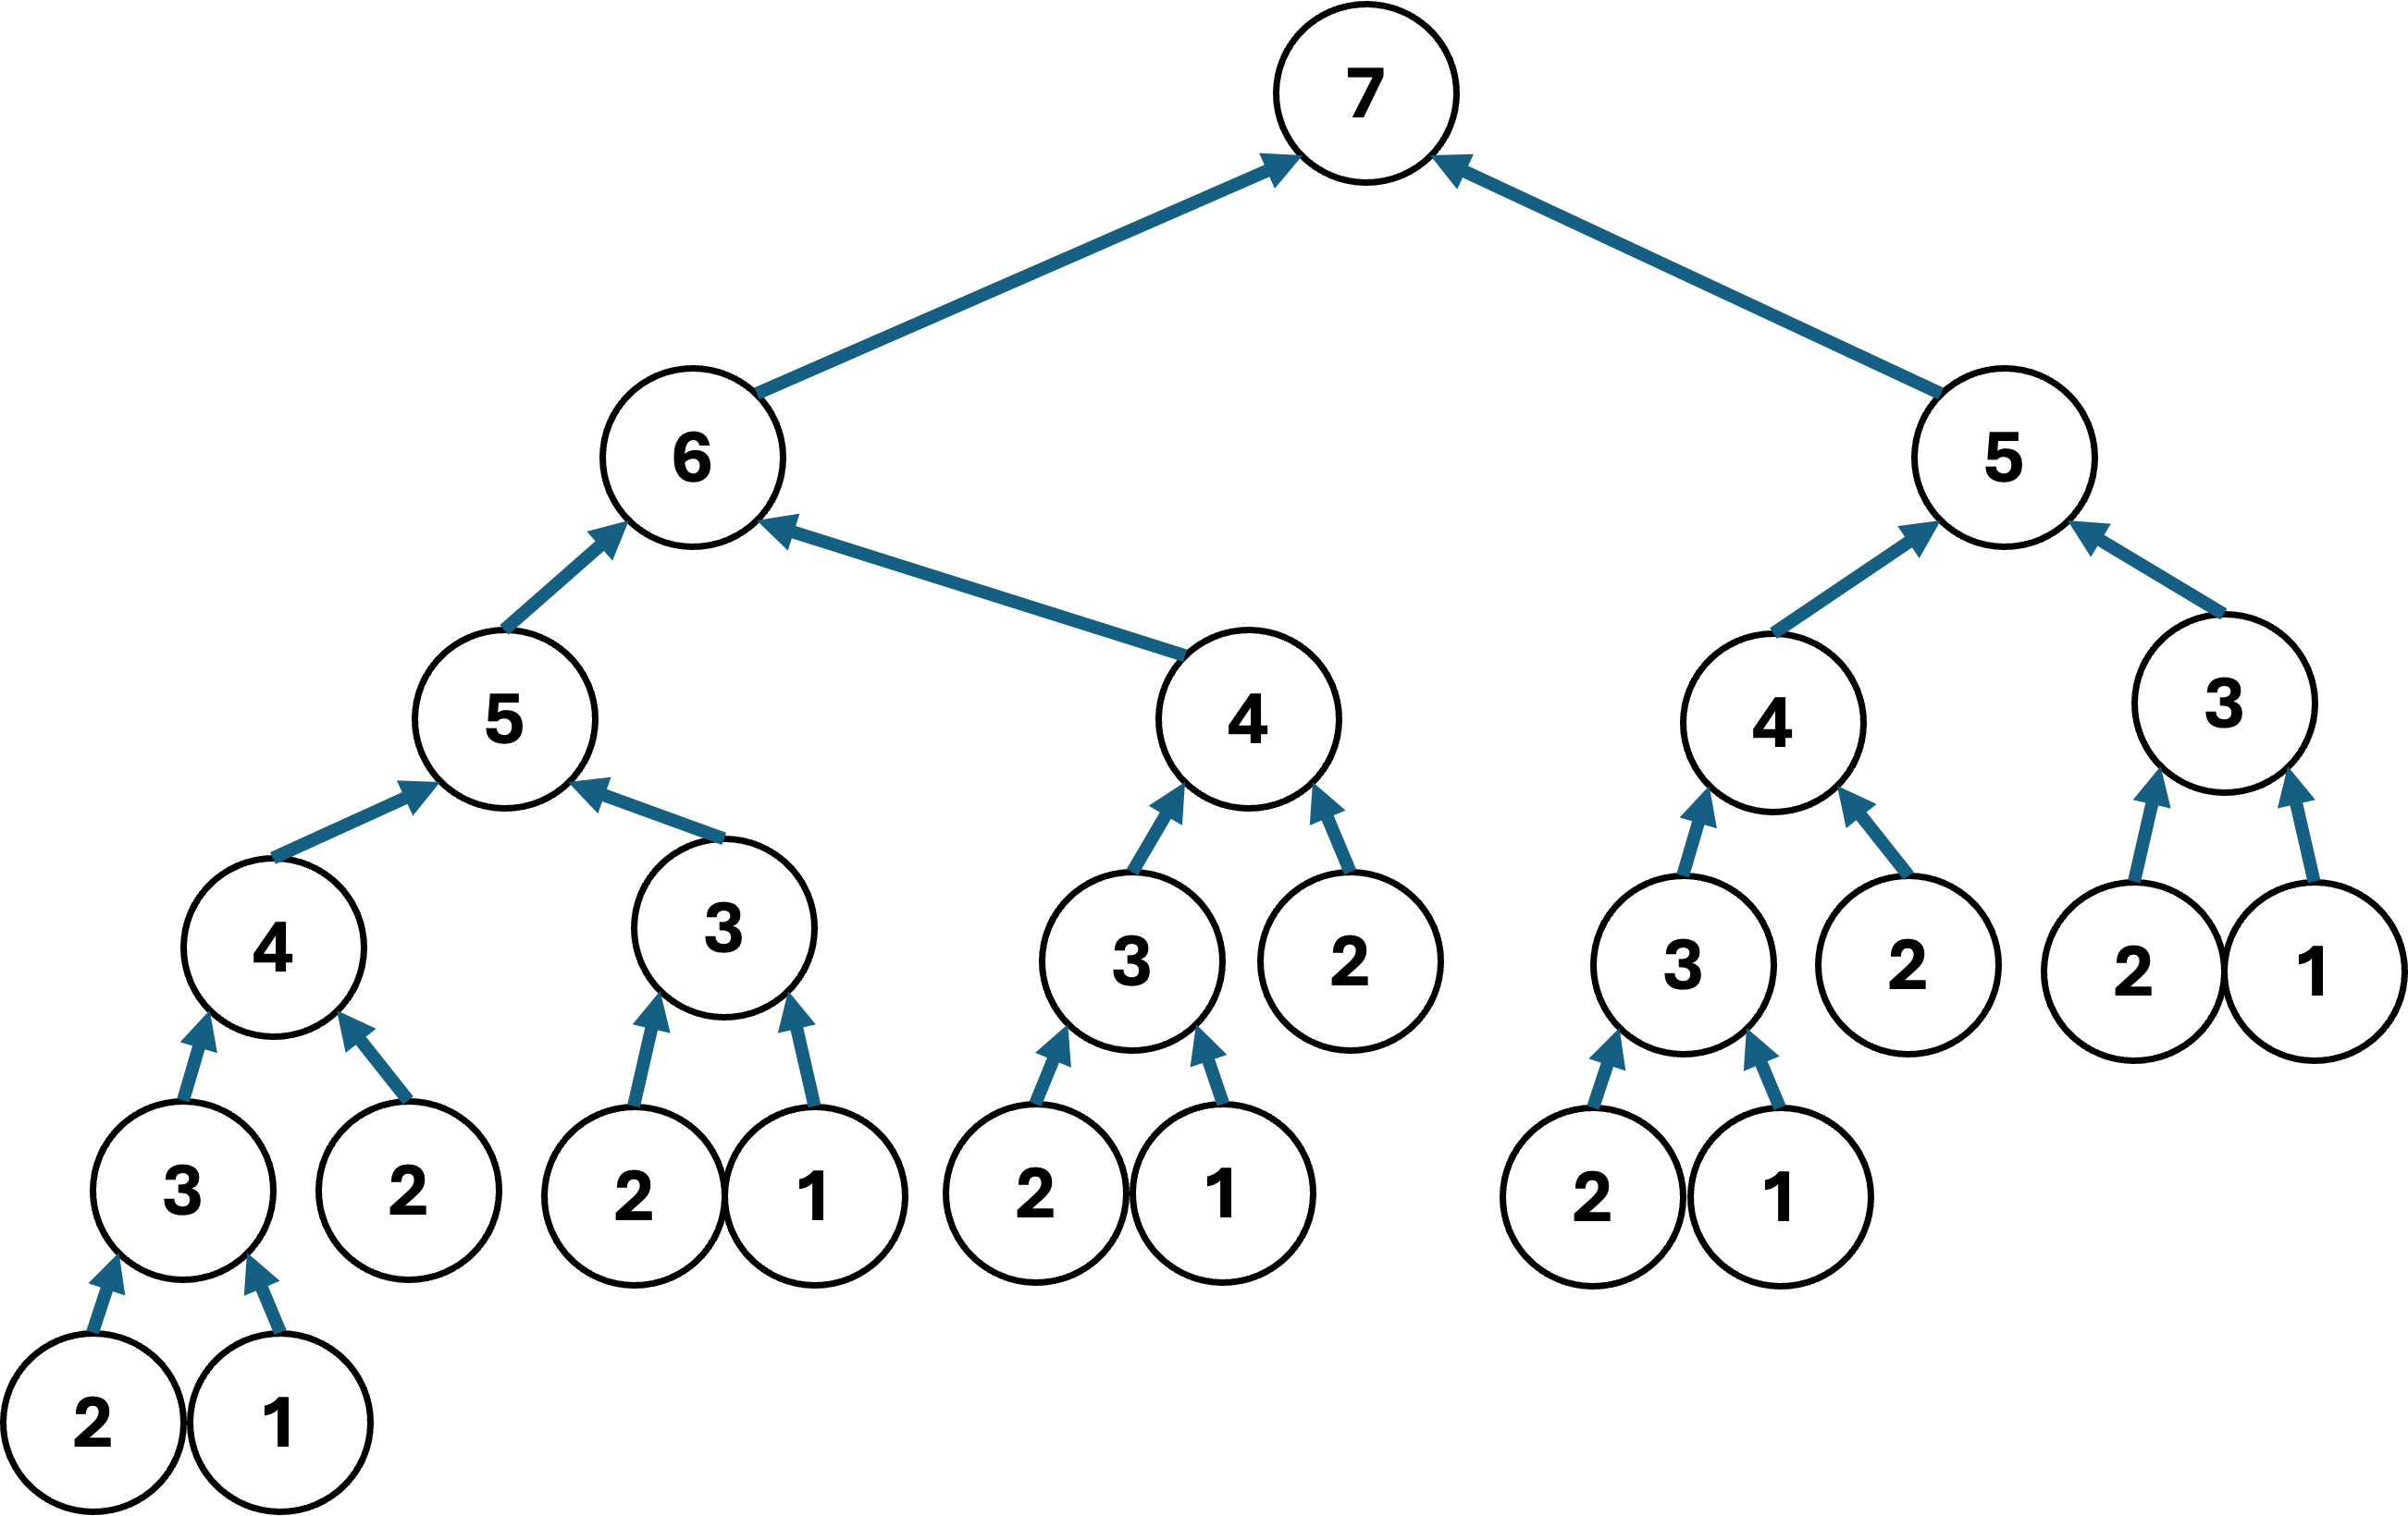
Fibonacci Sequence: Naïve Solution
def fib(n):
if n <= 2:
f = 1
else:
f = fib(n-1) + fib(n-2)
return n

Slide 10

Problems that are suitable for Dynamic Programming are has an optimal substructure where an optimal solution to the overall problem can be constructed from optimal solutions of its subproblems.
$$fib(7)$$
7
6
5
5
4
4
3
4
3
3
2
3
2
2
1
3
2
2
1
2
1
2
1
2
1

Slide 11
$$fib(7)$$
7
6
5
5
4
4
3
4
3
3
2
3
2
2
1
3
2
2
1
2
1
2
1
2
1

Slide 12
Problems that are suitable for Dynamic Programming are overlapping problems where the same subproblems are encountered and solved multiple times during the computation of the overall solution.
7
6
5
5
4
4
3
4
3
3
2
3
2
2
1
3
2
2
1
2
1
2
1
2
1

Slide 13
Problems that are suitable for Dynamic Programming are overlapping problems where the same subproblems are encountered and solved multiple times during the computation of the overall solution.
7
6
5
5
4
4
3
4
3
3
2
3
2
2
1
3
2
2
1
2
1
2
1
2
1

Slide 14
Problems that are suitable for Dynamic Programming are overlapping problems where the same subproblems are encountered and solved multiple times during the computation of the overall solution.
7
6
5
5
4
4
3
4
3
3
2
3
2
2
1
3
2
2
1
2
1
2
1
2
1

Slide 15
Fibonacci Sequence: DP using memoization
memo = {}
def fib(n):
if n in memo:
return memo[n]
if n <= 2:
f = 1
else:
f = fib(n-1) + fib(n-2)
return n
Remember and reuse
previously computed problem
Maintains a dictionary
Recursive call either:
Return a stored solution
Compute and store solution

Slide 16

Fibonacci Sequence: DP using memoization
memo = {}
def fib(n):
if n in memo:
return memo[n]
if n <= 2:
f = 1
else:
f = fib(n-1) + fib(n-2)
return n
$$fib(5)$$
5
4
3
3
2
2
1
2
1

Slide 17
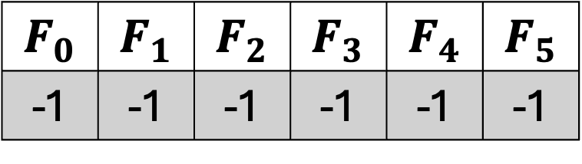
memo = {}
def fib(n):
if n in memo:
return memo[n]
if n <= 2:
f = 1
else:
f = fib(n-1) + fib(n-2)
return n
$$F_{0}$$ | $$F_{1}$$ | $$F_{2}$$ | $$F_{3}$$ | $$F_{4}$$ | $$F_{5}$$
-1 | -1 | -1 | -1 | -1 | -1
5
4
3
3
2
2
1
2
1

Slide 18
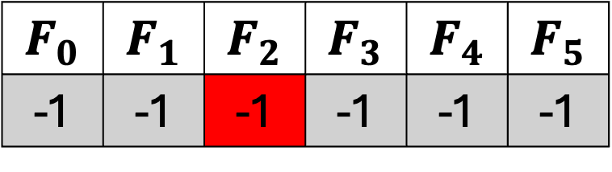

memo = {}
def fib(n):
if n in memo:
return memo[n]
if n <= 2:
f = 1
else:
f = fib(n-1) + fib(n-2)
return n
$$F_{0}$$ | $$F_{1}$$ | $$F_{2}$$ | $$F_{3}$$ | $$F_{4}$$ | $$F_{5}$$
-1 | -1 | -1 | -1 | -1 | -1
5
4
3
3
2
2
1
$$fib(2)$$
2
1

Slide 19
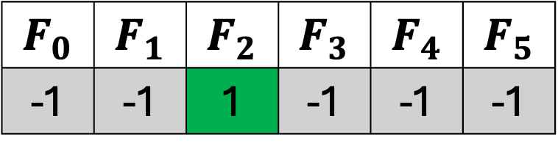
memo = {}
def fib(n):
if n in memo:
return memo[n]
if n <= 2:
f = 1
else:
f = fib(n-1) + fib(n-2)
return n
$$F_{0}$$ | $$F_{1}$$ | $$F_{2}$$ | $$F_{3}$$ | $$F_{4}$$ | $$F_{5}$$
-1 | -1 | 1 | -1 | -1 | -1
5
4
3
3
2
2
1
$$fib(2)$$
2
1

Slide 20
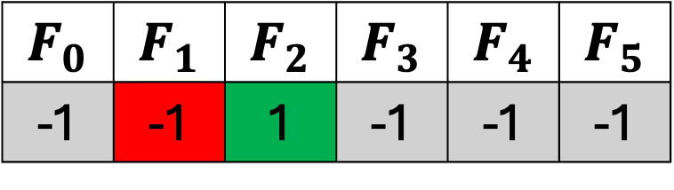

memo = {}
def fib(n):
if n in memo:
return memo[n]
if n <= 2:
f = 1
else:
f = fib(n-1) + fib(n-2)
return n
$$F_{0}$$ | $$F_{1}$$ | $$F_{2}$$ | $$F_{3}$$ | $$F_{4}$$ | $$F_{5}$$
-1 | -1 | 1 | -1 | -1 | -1
5
4
3
3
2
2
1
2
1
$$fib(1)$$

Slide 21
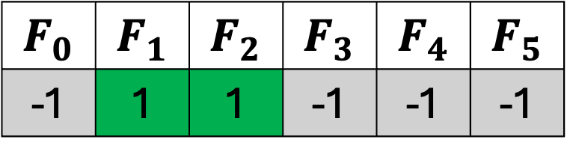
memo = {}
def fib(n):
if n in memo:
return memo[n]
if n <= 2:
f = 1
else:
f = fib(n-1) + fib(n-2)
return n
$$F_{0}$$ | $$F_{1}$$ | $$F_{2}$$ | $$F_{3}$$ | $$F_{4}$$ | $$F_{5}$$
-1 | 1 | 1 | -1 | -1 | -1
5
4
3
3
2
2
1
2
1
$$fib(1)$$

Slide 22
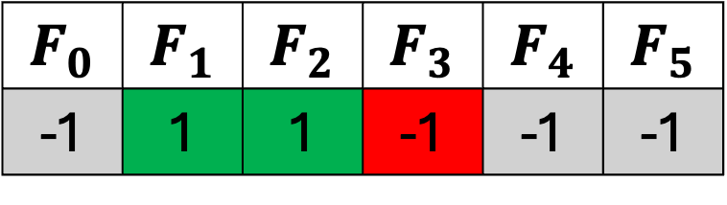

memo = {}
def fib(n):
if n in memo:
return memo[n]
if n <= 2:
f = 1
else:
f = fib(n-1) + fib(n-2)
return n
$$F_{0}$$ | $$F_{1}$$ | $$F_{2}$$ | $$F_{3}$$ | $$F_{4}$$ | $$F_{5}$$
-1 | 1 | 1 | -1 | -1 | -1
5
4
3
$$fib(3)$$
3
2
2
1
2
1

Slide 23
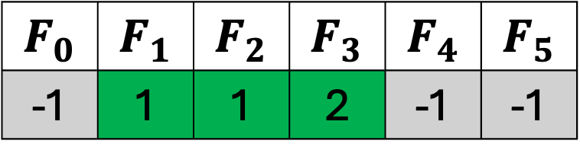
memo = {}
def fib(n):
if n in memo:
return memo[n]
if n <= 2:
f = 1
else:
f = fib(n-1) + fib(n-2)
return n
$$F_{0}$$ | $$F_{1}$$ | $$F_{2}$$ | $$F_{3}$$ | $$F_{4}$$ | $$F_{5}$$
-1 | 1 | 1 | 2 | -1 | -1
5
4
3
$$fib(3)$$
3
2
2
1
2
1

Slide 24

memo = {}
def fib(n):
if n in memo:
return memo[n]
if n <= 2:
f = 1
else:
f = fib(n-1) + fib(n-2)
return n
$$F_{0}$$ | $$F_{1}$$ | $$F_{2}$$ | $$F_{3}$$ | $$F_{4}$$ | $$F_{5}$$
-1 | 1 | 1 | 2 | -1 | -1
5
4
3
$$fib(2)$$
3
2
2
1
2
1

Slide 25
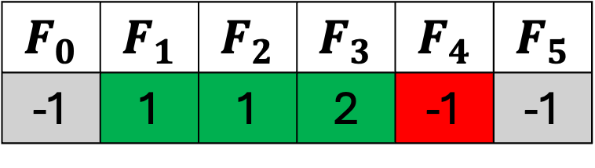

memo = {}
def fib(n):
if n in memo:
return memo[n]
if n <= 2:
f = 1
else:
f = fib(n-1) + fib(n-2)
return n
$$F_{0}$$ | $$F_{1}$$ | $$F_{2}$$ | $$F_{3}$$ | $$F_{4}$$ | $$F_{5}$$
-1 | 1 | 1 | 2 | -1 | -1
5
$$fib(4)$$
4
3
3
2
2
1
2
1

Slide 26
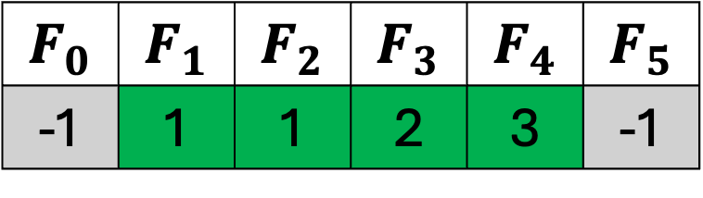
memo = {}
def fib(n):
if n in memo:
return memo[n]
if n <= 2:
f = 1
else:
f = fib(n-1) + fib(n-2)
return n
$$F_{0}$$ | $$F_{1}$$ | $$F_{2}$$ | $$F_{3}$$ | $$F_{4}$$ | $$F_{5}$$
-1 | 1 | 1 | 2 | 3 | -1
5
$$fib(4)$$
4
3
3
2
2
1
2
1

Slide 27
memo = {}
def fib(n):
if n in memo:
return memo[n]
if n <= 2:
f = 1
else:
f = fib(n-1) + fib(n-2)
return n
$$F_{0}$$ | $$F_{1}$$ | $$F_{2}$$ | $$F_{3}$$ | $$F_{4}$$ | $$F_{5}$$
-1 | 1 | 1 | 2 | 3 | -1
5
4
3
3
2
2
1
2
1
We do not need to recompute the
right side of the tree

Slide 28
memo = {}
def fib(n):
if n in memo:
return memo[n]
if n <= 2:
f = 1
else:
f = fib(n-1) + fib(n-2)
return n
$$F_{0}$$ | $$F_{1}$$ | $$F_{2}$$ | $$F_{3}$$ | $$F_{4}$$ | $$F_{5}$$
-1 | 1 | 1 | 2 | 3 | -1
5
4
3
3
2
2
1
2
1

Slide 29
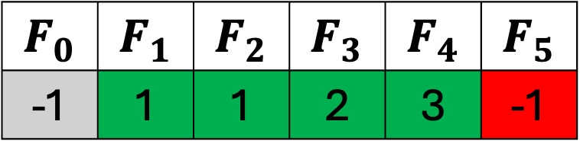

memo = {}
def fib(n):
if n in memo:
return memo[n]
if n <= 2:
f = 1
else:
f = fib(n-1) + fib(n-2)
return n
$$F_{0}$$ | $$F_{1}$$ | $$F_{2}$$ | $$F_{3}$$ | $$F_{4}$$ | $$F_{5}$$
-1 | 1 | 1 | 2 | 3 | -1
$$fib(5)$$
5
4
3
3
2
2
1
2
1

Slide 30
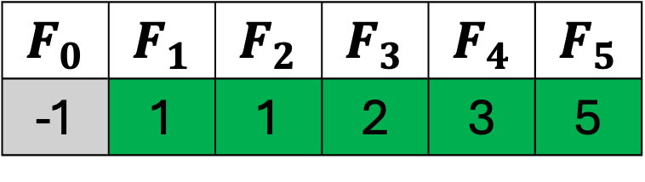
memo = {}
def fib(n):
if n in memo:
return memo[n]
if n <= 2:
f = 1
else:
f = fib(n-1) + fib(n-2)
return n
$$F_{0}$$ | $$F_{1}$$ | $$F_{2}$$ | $$F_{3}$$ | $$F_{4}$$ | $$F_{5}$$
-1 | 1 | 1 | 2 | 3 | 5
$$fib(5)$$
5
4
3
3
2
2
1
2
1

Slide 31
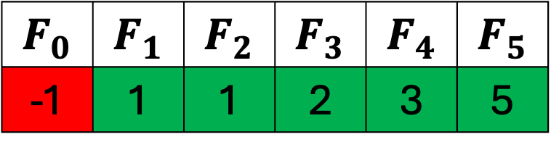

memo = {}
def fib(n):
if n in memo:
return memo[n]
if n <= 2:
f = 1
else:
f = fib(n-1) + fib(n-2)
return n
$$F_{0}$$ | $$F_{1}$$ | $$F_{2}$$ | $$F_{3}$$ | $$F_{4}$$ | $$F_{5}$$
-1 | 1 | 1 | 2 | 3 | 5
$$fib(0)$$
5
4
3
3
2
2
1
2
1

Slide 32
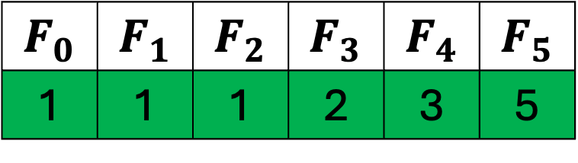
memo = {}
def fib(n):
if n in memo:
return memo[n]
if n <= 2:
f = 1
else:
f = fib(n-1) + fib(n-2)
return n
$$F_{0}$$ | $$F_{1}$$ | $$F_{2}$$ | $$F_{3}$$ | $$F_{4}$$ | $$F_{5}$$
1 | 1 | 1 | 2 | 3 | 5
$$fib(0)$$
5
4
3
3
2
2
1
2
1

Slide 33
How does Dynamic Programming apply to MDPs?
Dynamic Programming is a very general solution method for problems which have two properties
Optimal substructures
Overlapping subproblems
Markov decision processes satisfy both properties.

Slide 34
How does Dynamic Programming apply to MDPs?
Markov decision processes satisfy both properties.
Bellman equation gives recursive decomposition
The value function stores and reuses solutions.

Slide 35
How does Dynamic Programming apply to MDPs?
Dynamic programming assumes full knowledge of the MDP.
It is used for planning in an MDP.

Slide 36
How does Dynamic Programming apply to MDPs?
For Prediction:
Input: MDP $<𝒮, 𝒜,𝒫,ℛ,γ>$and policy $π$
Output: value function $v_{π}$

Slide 37
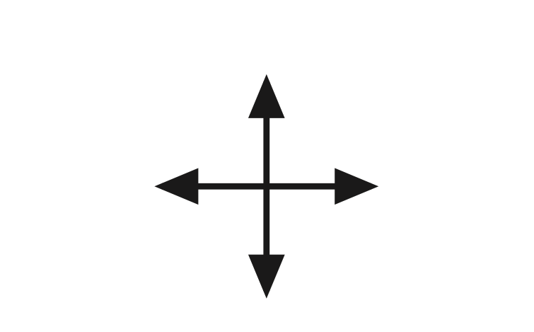
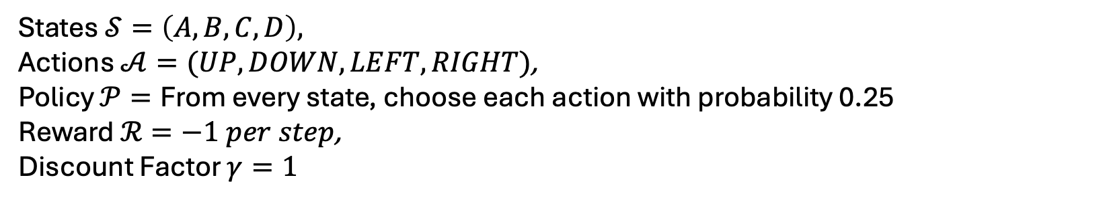
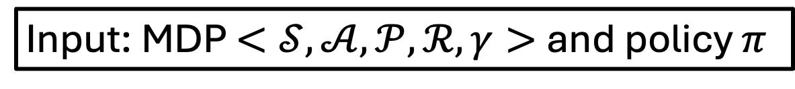
For Prediction: Gridworld Example
Input: MDP $<𝒮, 𝒜,𝒫,ℛ,γ>$and policy $π$
A | B
C | D
UP
LEFT
RIGHT
DOWN
States $𝒮=\left(A,B,C,D\right),$
Actions $𝒜=(UP, DOWN, LEFT, RIGHT)$,
Policy $𝒫=\text{From} \text{every} \text{state}\text{, }\text{choose} \text{each} \text{action} \text{with} \text{probability}\text{ 0.25}$
Reward $ℛ=−1 per step$,
Discount Factor $γ=1$

Slide 38
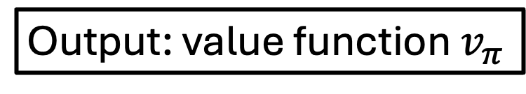
For Prediction: Gridworld Example
Output: value function $v_{π}$
-2 | -1
-1 | 0
For Prediction, we are finding the value function following a random policy $π$

Slide 39
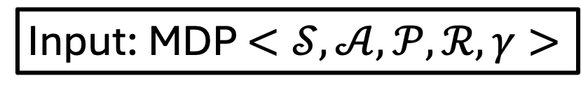
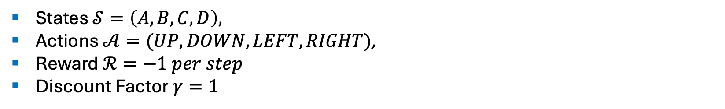
For Control: Gridworld Example
Input: MDP $<𝒮, 𝒜,𝒫,ℛ,γ>$
A | B
C | D
UP
LEFT
RIGHT
DOWN
States $𝒮=\left(A,B,C,D\right),$
Actions $𝒜=(UP, DOWN, LEFT, RIGHT)$,
Reward $ℛ=−1 per step$
Discount Factor $γ=1$

Slide 40
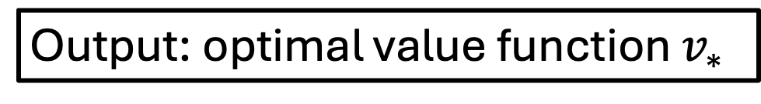

For Control: Gridworld Example
Output: optimal value function $v_{∗}$
-2 | -1
-1 | 0
For Control, we are finding the optimal value function $v_{∗}$ over all policies

Slide 41

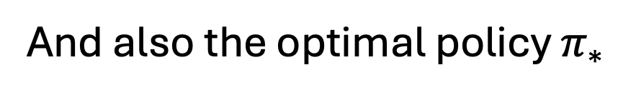
For Control: Gridworld Example
Output: optimal policy${ π}_{∗}$
-2 | -1
-1 | 0
And also the optimal policy $π_{∗}$

Slide 42
Outline
Dynamic Programming
Policy Evaluation
Policy Iteration
Value Iteration

Slide 43
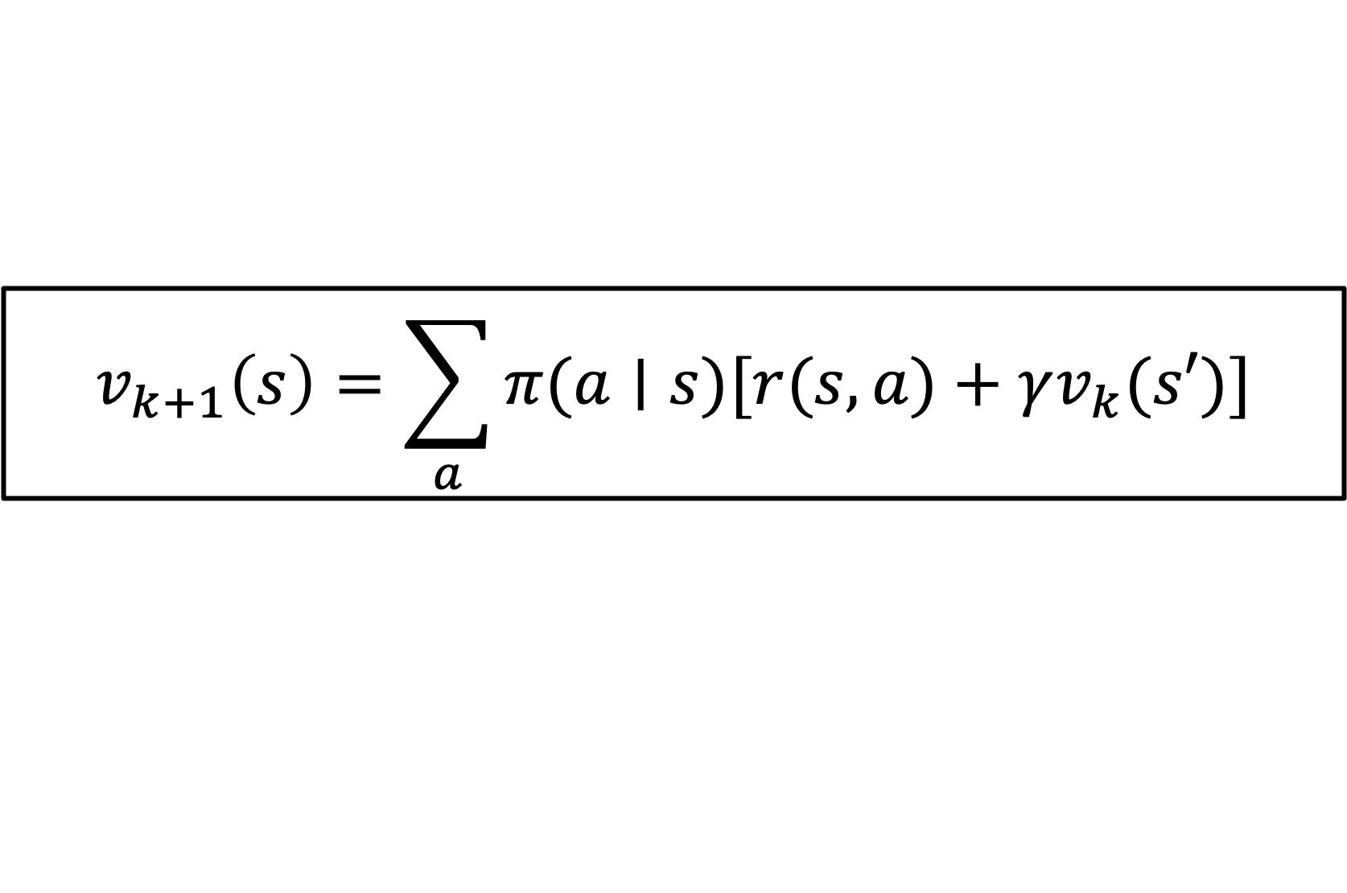
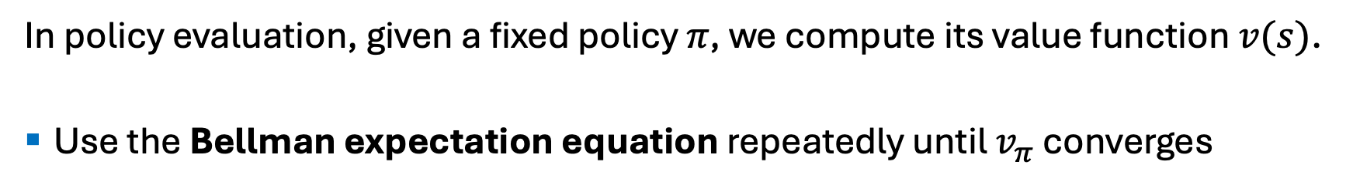
Policy Evaluation
In policy evaluation, given a fixed policy $π$, we compute its value function $v(s)$.
Use the Bellman expectation equation repeatedly until $v_{π}$​ converges
$$v_{k+1}\left(s\right)=\sum_{a}{π(a∣s)[r(s,a)+γv_{k}(s′)]}$$

Slide 44
Gridworld
a 2D grid where each cell represents a state.
An agent starts at a designated position and learns to navigate the grid by taking actions (like up, down, left, or right) to reach a goal state, while avoiding obstacles.
Rewards and penalties are given for actions and reaching certain states, helping the agent learn an optimal path through trial and error.

Slide 45
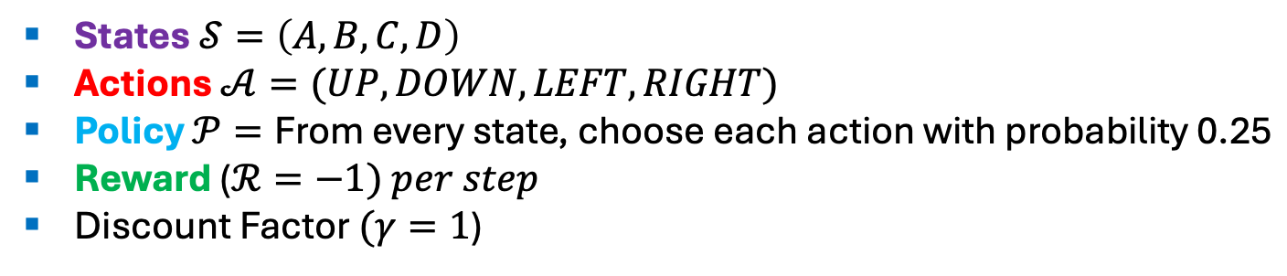
Example: 2x2 Gridworld
A | B
C | D
UP
LEFT
RIGHT
DOWN
States $𝒮=\left(A,B,C,D\right)$
Actions $𝒜=(UP, DOWN, LEFT, RIGHT)$
Policy $𝒫=\text{From} \text{every} \text{state}\text{, }\text{choose} \text{each} \text{action} \text{with} \text{probability}\text{ 0.25}$
Reward ($ℛ=−1) per step$
Discount Factor $(γ=1$)

Slide 46
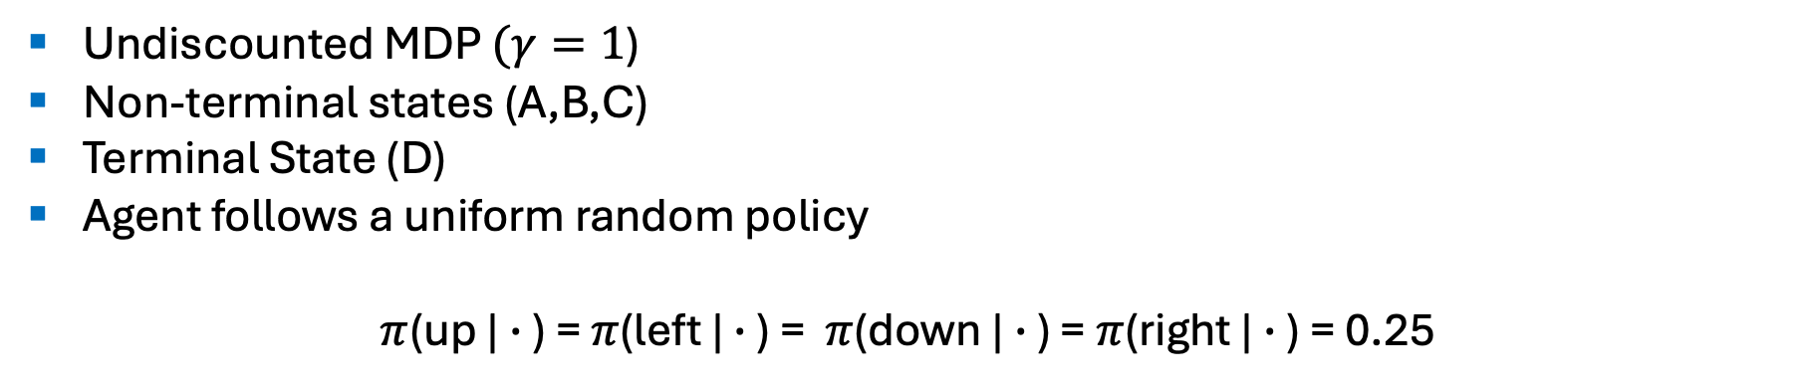
Example: 2x2 Gridworld
A | B
C | D
UP
LEFT
RIGHT
DOWN
Undiscounted MDP $(γ=1$)
Non-terminal states (A,B,C)
Terminal State (D)
Agent follows a uniform random policy
$π$(up | $∙$ ) = $π$(left | $∙$ ) = $π$(down | $∙$ ) = $π$(right | $∙$ ) = 0.25

Slide 47
Example: 2x2 Gridworld
A | B
C | D
UP
LEFT
RIGHT
DOWN
Rules:
From each state, actions move you in that direction if possible, otherwise you stay in the same square.
Reward is -1 until the terminal state is reached.
The goal is to reach state D which gives 0 reward and ends the episode.

Slide 48
 | UP | DOWN | LEFT | RIGHT
A | -1 | -1 | -1 | -1
B | -1 | 0 | -1 | -1
C | -1 | -1 | -1 | 0

Slide 49

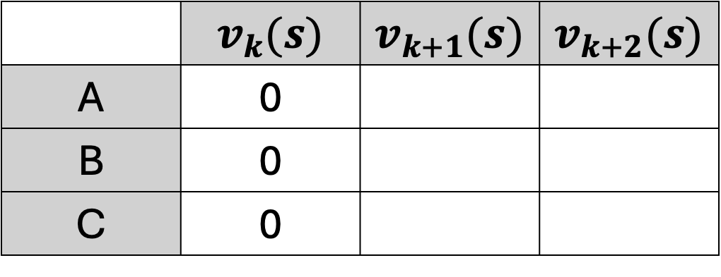
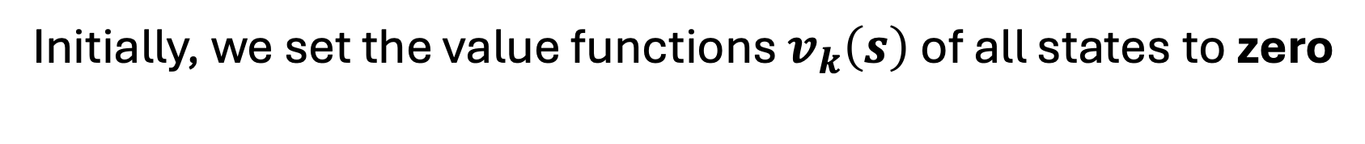
 | $$v_{k}(s)$$ | $$v_{k+1}(s)$$ | $$v_{k+2}(s)$$
A | 0
B | 0
C | 0
0 | 0
0
$$k=0$$
Initially, we set the value functions $v_{k}\left(s\right)$ of all states to zero

Slide 50
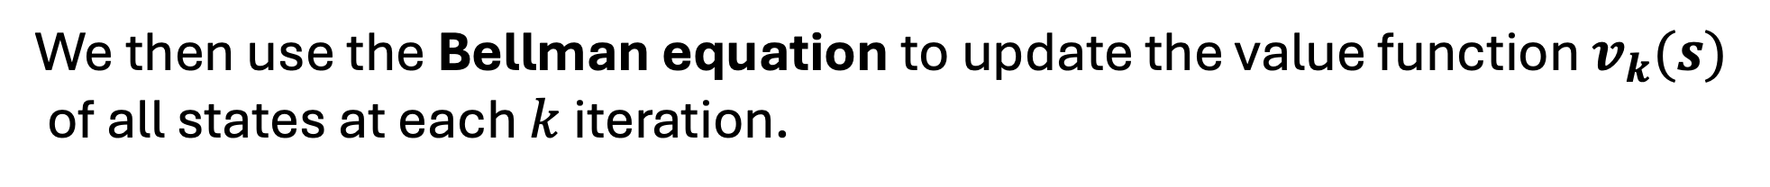
 | $$v_{k}(s)$$ | $$v_{k+1}(s)$$ | $$v_{k+2}(s)$$
A | 0
B | 0
C | 0
0 | 0
0
$$k=0$$
We then use the Bellman equation to update the value function $v_{k}(s)$
of all states at each $k$ iteration.

Slide 51
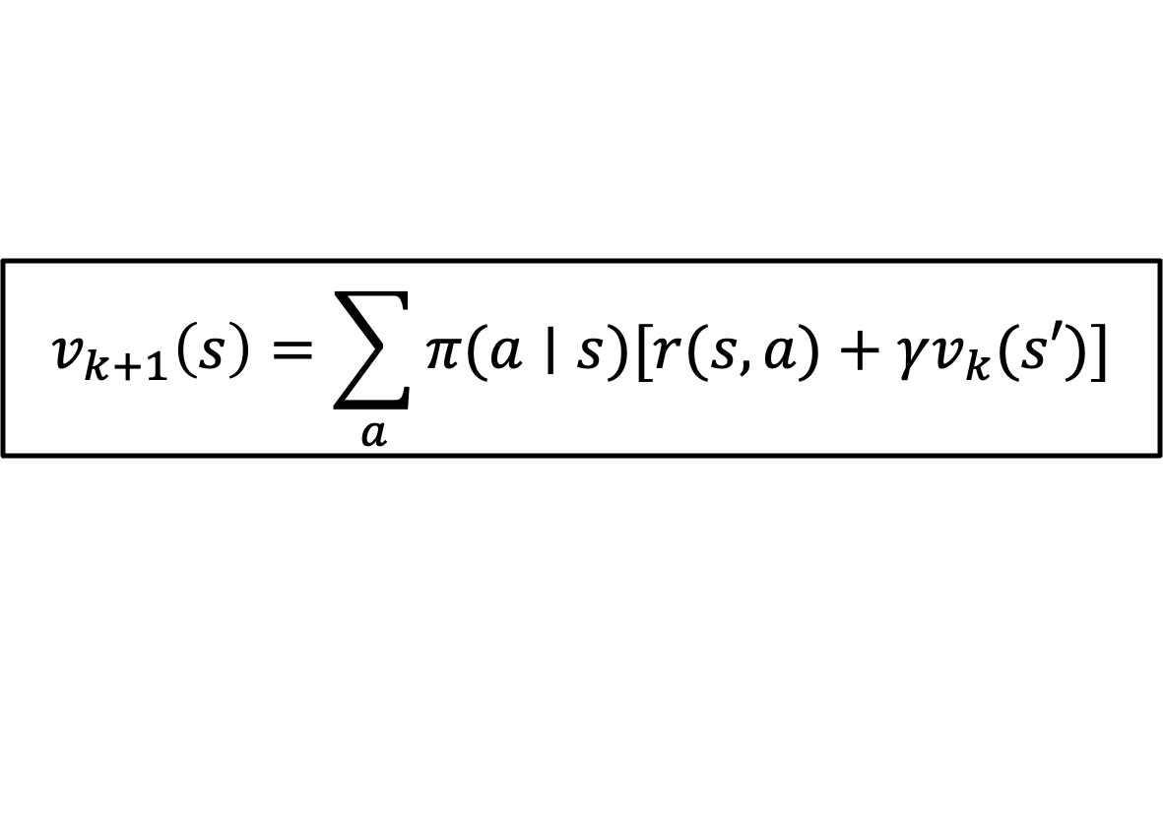
 | $$v_{k}(s)$$ | $$v_{k+1}(s)$$ | $$v_{k+2}(s)$$
A | 0
B | 0
C | 0
0 | 0
0
$$k=0$$
$$v_{k+1}\left(s\right)=\sum_{a}{π(a∣s)[r(s,a)+γv_{k}(s′)]}$$
$$v_{k+1}\left(A\right)=\frac{1}{4}​[(−1+v(A))+(−1+v(B))+(−1+v(C))+(−1+v(A))$$
Using the Bellman equation, we get this

Slide 52
 | $$v_{k}(s)$$ | $$v_{k+1}(s)$$ | $$v_{k+2}(s)$$
A | 0
B | 0
C | 0
0 | 0
0
$$k=0$$
$$v_{k+1}\left(s\right)=\sum_{a}{π(a∣s)[r(s,a)+γv_{k}(s′)]}$$
$$v_{k+1}\left(A\right)=\frac{1}{4}​[(−1+v(A))+(−1+v(B))+(−1+v(C))+(−1+v(A))$$
Let us this break down. To update the value function of state A, we get the sum of the immediate reward plus the value function of the next state for all possible actions from state A.

Slide 53
0 | 0
0
A | B
C | D
$$v_{k+1}\left(A\right)=\frac{1}{4}​[(−1+v(A))+(−1+v(B))+(−1+v(C))+(−1+v(A))$$
Let us this break down. To update the value function of state A, we get the sum of the immediate reward plus the value function of the next state for all possible actions from state A.

Slide 54
0 | 0
0
A | B
C | D
$$v_{k+1}\left(A\right)=\frac{1}{4}​[(−1+v(A))+(−1+v(B))+(−1+v(C))+(−1+v(A))$$
First term: When we go LEFT, we stay in state A and we will get a reward of -1 plus the value function of state A.

Slide 55
0 | 0
0
A | B
C | D
$$v_{k+1}\left(A\right)=\frac{1}{4}​[(−1+v(A))+(−1+v(B))+(−1+v(C))+(−1+v(A))$$
Second term: When we go RIGHT, we go to state B and we will get a reward of -1 plus the value function of state B.

Slide 56
0 | 0
0
A | B
C | D
$$v_{k+1}\left(A\right)=\frac{1}{4}​[(−1+v(A))+(−1+v(B))+(−1+v(C))+(−1+v(A))$$
Third term: When we go DOWN, we go to state C and we will get a reward of -1 plus the value function of state A.

Slide 57
0 | 0
0
A | B
C | D
$$v_{k+1}\left(A\right)=\frac{1}{4}​[(−1+v(A))+(−1+v(B))+(−1+v(C))+(−1+v(A))$$
Fourth term: When we go UP, we stay in state A and we will get a reward of -1 plus the value function of state A.

Slide 58

0 | 0
0
A | B
C | D
$$v_{k+1}\left(A\right)=\frac{1}{4}​[(−1+v(A))+(−1+v(B))+(−1+v(C))+(−1+v(A))$$
One fourth is the uniform random policy for all actions. The agent follows this policy of having a 25% probability of choosing action $𝓐$.

Slide 59
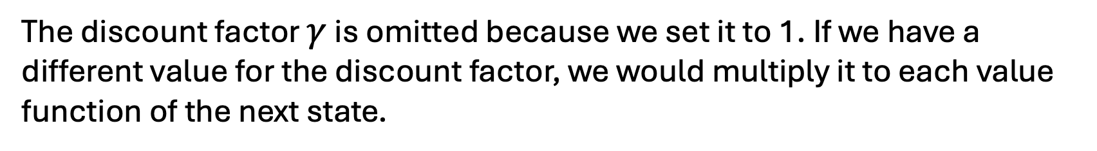
0 | 0
0
A | B
C | D
$$v_{k+1}\left(A\right)=\frac{1}{4}​[(−1+v(A))+(−1+v(B))+(−1+v(C))+(−1+v(A))$$
The discount factor $γ$ is omitted because we set it to 1. If we have a different value for the discount factor, we would multiply it to each value function of the next state.

Slide 60

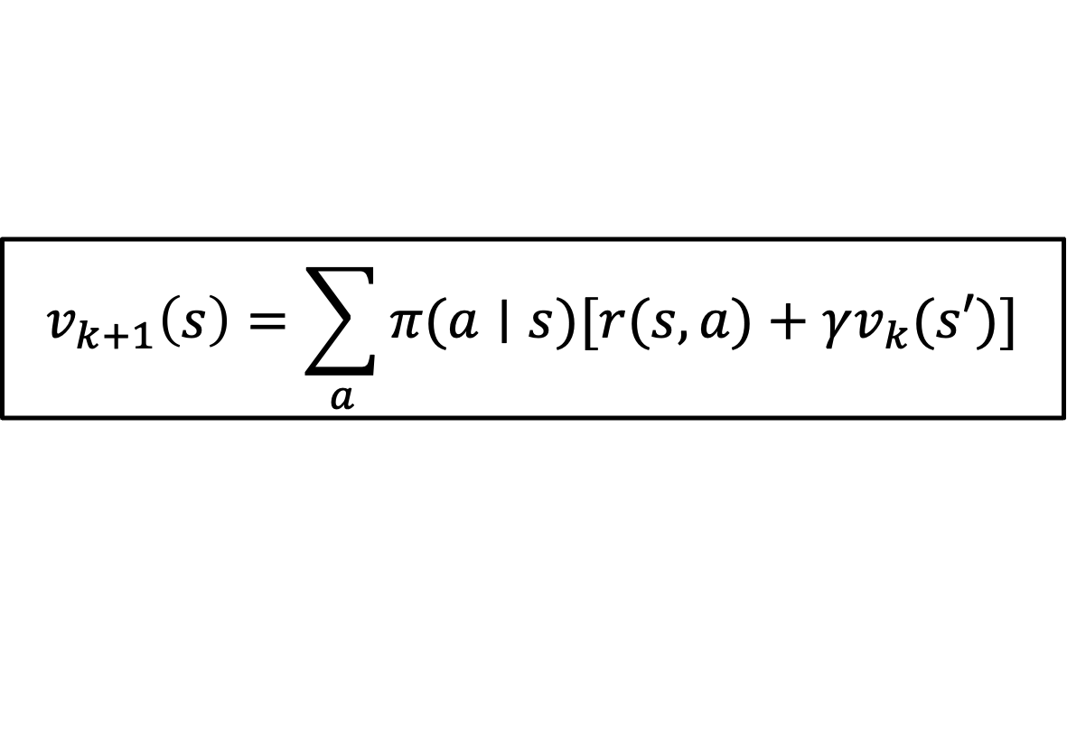

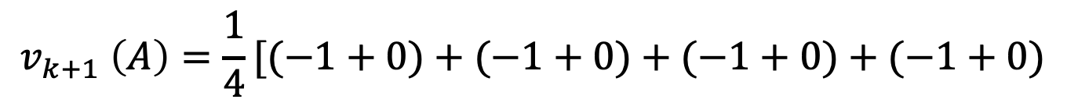
 | $$v_{k}(s)$$ | $$v_{k+1}(s)$$ | $$v_{k+2}(s)$$
A | 0
B | 0
C | 0
0 | 0
0
$$k=1$$
$$v_{k+1}\left(s\right)=\sum_{a}{π(a∣s)[r(s,a)+γv_{k}(s′)]}$$
$$v_{k+1}\left(A\right)=\frac{1}{4}​[(−1+v(A))+(−1+v(B))+(−1+v(C))+(−1+v(A))$$
$$v_{k+1} \left(A\right)=\frac{1}{4}​[(−1+0)+(−1+0)+(−1+0)+(−1+0)$$
$$v_{k+1}\left(A\right)=−1$$

Slide 61
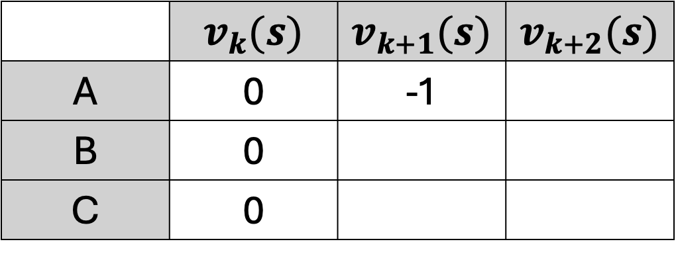

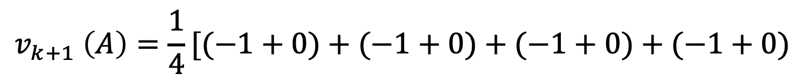
 | $$v_{k}(s)$$ | $$v_{k+1}(s)$$ | $$v_{k+2}(s)$$
A | 0 | -1
B | 0
C | 0
-1 | 0
0
$$k=1$$
$$v_{k+1}\left(A\right)=\frac{1}{4}​[(−1+v(A))+(−1+v(B))+(−1+v(C))+(−1+v(A))$$
$$v_{k+1} \left(A\right)=\frac{1}{4}​[(−1+0)+(−1+0)+(−1+0)+(−1+0)$$
$$v_{k+1}\left(A\right)=−1$$
We now store the new value function of state A

Slide 62

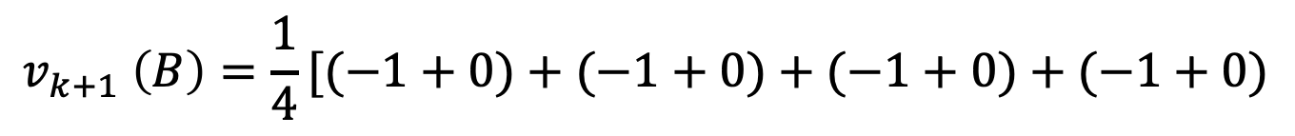
 | $$v_{k}(s)$$ | $$v_{k+1}(s)$$ | $$v_{k+2}(s)$$
A | 0 | -1
B | 0
C | 0
-1 | 0
0
$$k=1$$
$$v_{k+1}\left(B\right)=\frac{1}{4}​[(−1+v(A))+(−1+v(B))+(−1+v(D))+(−1+v(B))$$
$$v_{k+1} \left(B\right)=\frac{1}{4}​[(−1+0)+(−1+0)+(−1+0)+(−1+0)$$
$$v_{k+1}\left(B\right)=−1$$
We do the same process for state B

Slide 63


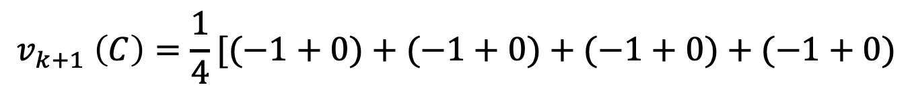
 | $$v_{k}(s)$$ | $$v_{k+1}(s)$$ | $$v_{k+2}(s)$$
A | 0 | -1
B | 0 | -1
C | 0
-1 | -1
0
$$k=1$$
$$v_{k+1}\left(C\right)=\frac{1}{4}​[(−1+v(C))+(−1+v(D))+(−1+v(C))+(−1+v(A))$$
$$v_{k+1} \left(C\right)=\frac{1}{4}​[(−1+0)+(−1+0)+(−1+0)+(−1+0)$$
$$v_{k+1}\left(C\right)=−1$$
And state C

Slide 64

 | $$v_{k}(s)$$ | $$v_{k+1}(s)$$ | $$v_{k+2}(s)$$
A | 0 | -1
B | 0 | -1
C | 0 | -1
-1 | -1
-1
$$k=1$$
$$v_{k+1}\left(C\right)=\frac{1}{4}​[(−1+v(C))+(−1+v(D))+(−1+v(C))+(−1+v(A))$$
$$v_{k+1} \left(C\right)=\frac{1}{4}​[(−1+0)+(−1+0)+(−1+0)+(−1+0)$$
$$v_{k+1}\left(C\right)=−1$$
And state C

Slide 65


0 | 0
0 | 0
-1 | -1
-1 | 0
$$k=0$$
$$k=1$$
After one iteration, the value functions for states A, B and C were changed from -1 to 0.

Slide 66

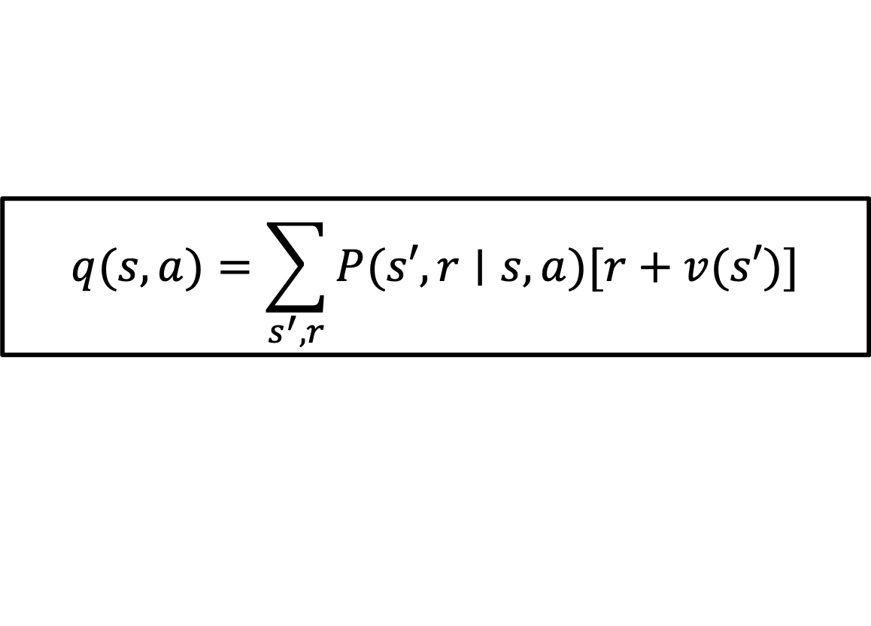
-1 | -1
-1 | 0
$$k=1$$
$$q(s,a)=\sum_{s^{′},r}{P(s′,r∣s,a)[r+v(s′)]}$$
We now use the Bellman equation to compute the action-value functions for each state to improve our existing policy.

Slide 67
-1 | -1
-1 | 0
$$k=1$$
$$q(s,a)=\sum_{s^{′},r}{P(s′,r∣s,a)[r+v(s′)]}$$
Let us start computing the action-value functions of state A

Slide 68
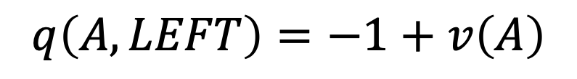
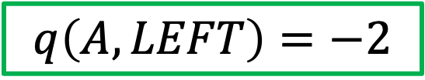
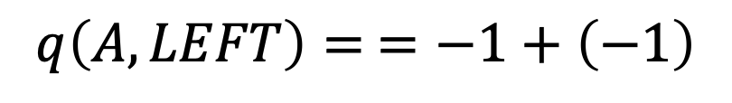
-1 | -1
-1 | 0
$$k=1$$
$$q(s,a)=\sum_{s^{′},r}{P(s′,r∣s,a)[r+v(s′)]}$$
$$q\left(A,LEFT\right)=−1+v\left(A\right)$$
$$q\left(A,LEFT\right)= =−1+\left(−1\right)$$
$$q\left(A,LEFT\right)=−2$$

Slide 69
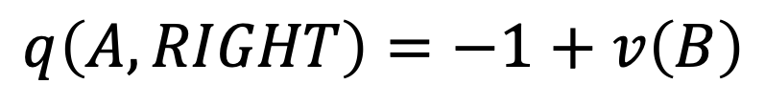


-1 | -1
-1 | 0
$$k=1$$
$$q(s,a)=\sum_{s^{′},r}{P(s′,r∣s,a)[r+v(s′)]}$$
$$q\left(A,RIGHT\right)=−1+v\left(B\right)$$
$$q\left(A,RIGHT\right)= =−1+\left(−1\right)$$
$$q\left(A,RIGHT\right)=−2$$

Slide 70



-1 | -1
-1 | 0
$$k=1$$
$$q(s,a)=\sum_{s^{′},r}{P(s′,r∣s,a)[r+v(s′)]}$$
$$q\left(A,DOWN\right)=−1+v\left(C\right)$$
$$q\left(A,DOWN\right)= =−1+\left(−1\right)$$
$$q\left(A,DOWN\right)=−2$$

Slide 71



-1 | -1
-1 | 0
$$k=1$$
$$q(s,a)=\sum_{s^{′},r}{P(s′,r∣s,a)[r+v(s′)]}$$
$$q\left(A,UP\right)=−1+v\left(A\right)$$
$$q\left(A,UP\right)= =−1+\left(−1\right)$$
$$q\left(A,UP\right)=−2$$

Slide 72




$$q\left(A,UP\right)=−2$$
$$q\left(A,LEFT\right)=−2$$
$$q\left(A,RIGHT\right)=−2$$
$$q\left(A,DOWN\right)=−2$$
We can now map the value for each action from state A

Slide 73
$$q\left(A,UP\right)=−2$$
$$q\left(A,LEFT\right)=−2$$
$$q\left(A,RIGHT\right)=−2$$
$$q\left(A,DOWN\right)=−2$$
This simply tells us that from state A, there is no best action to take because all of their values are the same.

Slide 74
$$q\left(A,UP\right)=−2$$
$$q\left(A,LEFT\right)=−2$$
$$q\left(A,RIGHT\right)=−2$$
$$q\left(A,DOWN\right)=−2$$
Because all of the values are the same, the policy will also be the same for state A

Slide 75
Let us now calculate the action-value functions for state B

Slide 76
-1 | -1
-1 | 0
$$k=1$$
$$q(s,a)=\sum_{s^{′},r}{P(s′,r∣s,a)[r+v(s′)]}$$
Similar to state A, we use the Bellman equation to compute the action-value functions for state B.

Slide 77



-1 | -1
-1 | 0
$$k=1$$
$$q(s,a)=\sum_{s^{′},r}{P(s′,r∣s,a)[r+v(s′)]}$$
$$q\left(B,LEFT\right)=−1+v\left(A\right)$$
$$q\left(B,LEFT\right)=−1+\left(−1\right)$$
$$q\left(B,LEFT\right)=−2$$

Slide 78



-1 | -1
-1 | 0
$$k=1$$
$$q(s,a)=\sum_{s^{′},r}{P(s′,r∣s,a)[r+v(s′)]}$$
$$q\left(B,RIGHT\right)=−1+v\left(B\right)$$
$$q\left(B,RIGHT\right)=−1+\left(−1\right)$$
$$q\left(B,RIGHT\right)=−2$$

Slide 79



-1 | -1
-1 | 0
$$k=1$$
$$q(s,a)=\sum_{s^{′},r}{P(s′,r∣s,a)[r+v(s′)]}$$
$$q\left(B,DOWN\right)=−1+v\left(D\right)$$
$$q\left(B,DOWN\right)=−1+\left(0\right)$$
$$q\left(B,DOWN\right)=−1$$

Slide 80



-1 | -1
-1 | 0
$$k=1$$
$$q(s,a)=\sum_{s^{′},r}{P(s′,r∣s,a)[r+v(s′)]}$$
$$q\left(B,UP\right)=−1+v\left(B\right)$$
$$q\left(B,UP\right)=−1+\left(−1\right)$$
$$q\left(B,UP\right)=−2$$

Slide 81




$$q\left(B,UP\right)=−2$$
$$q\left(B,LEFT\right)=−2$$
$$q\left(B,RIGHT\right)=−2$$
$$q\left(B,DOWN\right)=−1$$
We can now map the value for each action from state B

Slide 82



$$q\left(B,UP\right)=−2$$
$$q\left(B,LEFT\right)=−2$$
$$q\left(B,RIGHT\right)=−2$$
$$q\left(B,DOWN\right)=−1$$
This simply tells us that from state B, the best action to take is to go DOWN because going down has the highest value of all actions.

Slide 83
$$q\left(B,UP\right)=−2$$
$$q\left(B,LEFT\right)=−2$$
$$q\left(B,RIGHT\right)=−2$$
$$q\left(B,DOWN\right)=−1$$
Which makes sense because going DOWN will go to our goal which is state D.

Slide 84

$$q\left(B,UP\right)=−2$$
$$q\left(B,LEFT\right)=−2$$
$$q\left(B,RIGHT\right)=−2$$
$$q\left(B,DOWN\right)=−1$$
Because of this, we can now update the policy for state B.
$$π\left(B\right)=\{DOWN\}$$

Slide 85
Let us now calculate the action-value functions for state C

Slide 86
-1 | -1
-1 | 0
$$k=1$$
$$q(s,a)=\sum_{s^{′},r}{P(s′,r∣s,a)[r+v(s′)]}$$
Similar to state A and B, we use the Bellman equation to compute the action-value functions for state C.

Slide 87



-1 | -1
-1 | 0
$$k=1$$
$$q(s,a)=\sum_{s^{′},r}{P(s′,r∣s,a)[r+v(s′)]}$$
$$q\left(C,LEFT\right)=−1+v\left(C\right)$$
$$q\left(C,LEFT\right)=−1+\left(−1\right)$$
$$q\left(C,LEFT\right)=−2$$

Slide 88



-1 | -1
-1 | 0
$$k=1$$
$$q(s,a)=\sum_{s^{′},r}{P(s′,r∣s,a)[r+v(s′)]}$$
$$q\left(C,RIGHT\right)=−1+v\left(D\right)$$
$$q\left(C,RIGHT\right)=−1+\left(0\right)$$
$$q\left(C,RIGHT\right)=−1$$

Slide 89



-1 | -1
-1 | 0
$$k=1$$
$$q(s,a)=\sum_{s^{′},r}{P(s′,r∣s,a)[r+v(s′)]}$$
$$q\left(C,DOWN\right)=−1+v\left(C\right)$$
$$q\left(C,DOWN\right)=−1+\left(−1\right)$$
$$q\left(C,DOWN\right)=−2$$

Slide 90



-1 | -1
-1 | 0
$$k=1$$
$$q(s,a)=\sum_{s^{′},r}{P(s′,r∣s,a)[r+v(s′)]}$$
$$q\left(C,UP\right)=−1+v\left(A\right)$$
$$q\left(C,UP\right)=−1+\left(−1\right)$$
$$q\left(C,UP\right)=−2$$

Slide 91




$$q\left(C,UP\right)=−2$$
$$q\left(C,LEFT\right)=−2$$
$$q\left(C,RIGHT\right)=−1$$
$$q\left(C,DOWN\right)=−2$$
We can now map the value for each action from state C

Slide 92



$$q\left(C,UP\right)=−2$$
$$q\left(C,LEFT\right)=−2$$
$$q\left(C,RIGHT\right)=−1$$
$$q\left(C,DOWN\right)=−2$$
This simply tells us that from state C, the best action to take is to go RIGHT because going right has the highest value of all actions.

Slide 93
$$q\left(C,UP\right)=−2$$
$$q\left(C,LEFT\right)=−2$$
$$q\left(C,RIGHT\right)=−1$$
$$q\left(C,DOWN\right)=−2$$
Which makes sense because going RIGHT will go to our goal which is state D.

Slide 94



$$q\left(C,UP\right)=−2$$
$$q\left(C,LEFT\right)=−2$$
$$q\left(C,RIGHT\right)=−2$$
$$q\left(C,DOWN\right)=−1$$
Just like before, we can now update our policy for state C.
$$π\left(C\right)=\{RIGHT\}$$

Slide 95




$$k=0$$
$$π\left(A\right)=\{LEFT,RIGHT,UP,DOWN\}$$
$$π\left(B\right)=\{LEFT,RIGHT,UP,DOWN\}$$
$$π\left(C\right)=\{LEFT,RIGHT,UP,DOWN\}$$
Initially, we started with this uniform random policy

Slide 96




$$k=1$$
$$π\left(A\right)=\{LEFT,RIGHT,UP,DOWN\}$$
$$π\left(B\right)=\{DOWN\}$$
$$π\left(C\right)=\{RIGHT\}$$
After 1 iteration, we improved our previous policy.

Slide 97

$$k=1$$
$$π\left(A\right)=\{LEFT,RIGHT,UP,DOWN\}$$
$$π\left(B\right)=\{DOWN\}$$
$$π\left(C\right)=\{RIGHT\}$$
Let us do one last iteration if we can reach convergence, or in RL terms, find the optimal policy $π_{∗}$

Slide 98




 | $$v_{k}(s)$$ | $$v_{k+1}(s)$$ | $$v_{k+2}(s)$$
A | 0 | -1 | -2
B | 0 | -1
C | 0 | -1
-2 | -1
-1
$$k=1$$
$$v_{k+2}\left(s\right)=\sum_{a}{π(a∣s)[r(s,a)+γv_{k+1}(s′)]}$$
$$v_{k+2}\left(A\right)=\frac{1}{4}​[(−1+v_{k+1}(A))+(−1+v_{k+1}(B))+(−1+v_{k+1}(C))+(−1+v_{k+1}(A))$$
$$v_{k+2} \left(A\right)=\frac{1}{4}​[(−1−1)+(−1−1)+(−1−1)+(−1−1)$$
$$v_{k+2}\left(A\right)=−2$$

Slide 99



 | $$v_{k}(s)$$ | $$v_{k+1}(s)$$ | $$v_{k+2}(s)$$
A | 0 | -1 | -2
B | 0 | -1 | -1.75
C | 0 | -1
-2 | -1.75
-1
$$k=1$$
$$v_{k+2}\left(s\right)=\sum_{a}{π(a∣s)[r(s,a)+γv_{k+1}(s′)]}$$
$$v_{k+2}\left(B\right)=\frac{1}{4}​[(−1+v_{k+1}(A))+(−1+v_{k+1}(B))+(−1+v_{k+1}(D))+(−1+v_{k+1}(B))$$
$$v_{k+2} \left(B\right)=\frac{1}{4}​[(−1−1)+(−1−1)+(−1+0)+(−1−1)$$
$$v_{k+2}\left(B\right)=−1.75$$

Slide 100



 | $$v_{k}(s)$$ | $$v_{k+1}(s)$$ | $$v_{k+2}(s)$$
A | 0 | -1 | -2
B | 0 | -1 | -1.75
C | 0 | -1 | -1.75
-2 | -1.75
-1.75
$$k=1$$
$$v_{k+2}\left(s\right)=\sum_{a}{π(a∣s)[r(s,a)+γv_{k+1}(s′)]}$$
$$v_{k+2}\left(C\right)=\frac{1}{4}​[(−1+v_{k+1}(C))+(−1+v_{k+1}(D))+(−1+v_{k+1}(C))+(−1+v_{k+1}(A))$$
$$v_{k+2} \left(C\right)=\frac{1}{4}​[(−1−1)+(−1+0)+(−1)+(−1−1)$$
$$v_{k+2}\left(C\right)=−1.75$$

Slide 101



-2 | -1.75
-1.75 | 0
$$k=2$$
$$q(s,a)=\sum_{s^{′},r}{P(s′,r∣s,a)[r+v(s′)]}$$
$$q\left(A,LEFT\right)=−1+v\left(A\right)$$
$$q\left(A,LEFT\right)= =−1+\left(−2\right)$$
$$q\left(A,LEFT\right)=−3$$

Slide 102


-2 | -1.75
-1.75 | 0
$$k=2$$
$$q(s,a)=\sum_{s^{′},r}{P(s′,r∣s,a)[r+v(s′)]}$$
$$q\left(A,RIGHT\right)=−1+v\left(B\right)$$
$$q\left(A,RIGHT\right)= =−1+\left(−1.75\right)$$
$$q\left(A,RIGHT\right)=−2.75$$

Slide 103


-2 | -1.75
-1.75 | 0
$$k=2$$
$$q(s,a)=\sum_{s^{′},r}{P(s′,r∣s,a)[r+v(s′)]}$$
$$q\left(A,DOWN\right)=−1+v\left(C\right)$$
$$q\left(A,DOWN\right)= =−1+\left(−1.75\right)$$
$$q\left(A,DOWN\right)=−2.75$$

Slide 104


-2 | -1.75
-1.75 | 0
$$k=2$$
$$q(s,a)=\sum_{s^{′},r}{P(s′,r∣s,a)[r+v(s′)]}$$
$$q\left(A,UP\right)=−1+v\left(A\right)$$
$$q\left(A,UP\right)= =−1+\left(−2\right)$$
$$q\left(A,UP\right)=−3$$

Slide 105




$$q\left(A,UP\right)=−3$$
$$q\left(A,LEFT\right)=−3$$
$$q\left(A,RIGHT\right)=−2.75$$
$$q\left(A,DOWN\right)=−2.75$$
We can now map the value for each action from state A

Slide 106



$$q\left(A,UP\right)=−3$$
$$q\left(A,LEFT\right)=−3$$
$$q\left(A,RIGHT\right)=−2.75$$
$$q\left(A,DOWN\right)=−2.75$$
And update the existing policy for state A
$$π\left(A\right)=\{RIGHT, DOWN\}$$

Slide 107


-2 | -1.75
-1.75 | 0
$$k=2$$
$$q(s,a)=\sum_{s^{′},r}{P(s′,r∣s,a)[r+v(s′)]}$$
$$q\left(B,LEFT\right)=−1+v\left(A\right)$$
$$q\left(B,LEFT\right)=−1+\left(−2\right)$$
$$q\left(B,LEFT\right)=−−3$$

Slide 108


-2 | -1.75
-1.75 | 0
$$k=2$$
$$q(s,a)=\sum_{s^{′},r}{P(s′,r∣s,a)[r+v(s′)]}$$
$$q\left(B,RIGHT\right)=−1+v\left(B\right)$$
$$q\left(B,RIGHT\right)=−1+\left(−1.75\right)$$
$$q\left(B,RIGHT\right)=−2.75$$

Slide 109
-2 | -1.75
-1.75 | 0
$$k=2$$
$$q(s,a)=\sum_{s^{′},r}{P(s′,r∣s,a)[r+v(s′)]}$$
$$q\left(B,DOWN\right)=−1+v\left(D\right)$$
$$q\left(B,DOWN\right)=−1+\left(0\right)$$
$$q\left(B,DOWN\right)=−1$$

Slide 110



-2 | -1.75
-1.75 | 0
$$k=2$$
$$q(s,a)=\sum_{s^{′},r}{P(s′,r∣s,a)[r+v(s′)]}$$
$$q\left(B,UP\right)=−1+v\left(B\right)$$
$$q\left(B,UP\right)=−1+\left(−1.75\right)$$
$$q\left(B,UP\right)=−2.75$$

Slide 111




$$q\left(B,UP\right)=−2.75$$
$$q\left(B,LEFT\right)=−3$$
$$q\left(B,RIGHT\right)=−2.75$$
$$q\left(B,DOWN\right)=−1$$
We can now map the value for each action from state B

Slide 112




$$q\left(B,UP\right)=−2.75$$
$$q\left(B,LEFT\right)=−3$$
$$q\left(B,RIGHT\right)=−2.75$$
$$q\left(B,DOWN\right)=−1$$
Because DOWN has the highest action-value function The policy of state B will not change
$$π\left(B\right)=\{DOWN\}$$

Slide 113


-2 | -1.75
-1.75 | 0
$$k=2$$
$$q(s,a)=\sum_{s^{′},r}{P(s′,r∣s,a)[r+v(s′)]}$$
$$q\left(C,LEFT\right)=−1+v\left(C\right)$$
$$q\left(C,LEFT\right)=−1+\left(−1.75\right)$$
$$q\left(C,LEFT\right)=−2.75$$

Slide 114


-2 | -1.75
-1.75 | 0
$$k=2$$
$$q(s,a)=\sum_{s^{′},r}{P(s′,r∣s,a)[r+v(s′)]}$$
$$q\left(C,RIGHT\right)=−1+v\left(D\right)$$
$$q\left(C,RIGHT\right)=−1+\left(0\right)$$
$$q\left(C,RIGHT\right)=−1$$

Slide 115


-2 | -1.75
-1.75 | 0
$$k=2$$
$$q(s,a)=\sum_{s^{′},r}{P(s′,r∣s,a)[r+v(s′)]}$$
$$q\left(C,DOWN\right)=−1+v\left(C\right)$$
$$q\left(C,DOWN\right)=−1+\left(−1.75\right)$$
$$q\left(C,DOWN\right)=−2.75$$

Slide 116



-2 | -1.75
-1.75 | 0
$$k=2$$
$$q(s,a)=\sum_{s^{′},r}{P(s′,r∣s,a)[r+v(s′)]}$$
$$q\left(C,UP\right)=−1+v\left(A\right)$$
$$q\left(C,UP\right)=−1+\left(−2\right)$$
$$q\left(C,UP\right)=−3$$

Slide 117




$$q\left(C,UP\right)=−3$$
$$q\left(C,LEFT\right)=−2.75$$
$$q\left(C,RIGHT\right)=−1$$
$$q\left(C,DOWN\right)=−2.75$$
We can now map the value for each action from state C and update our policy

Slide 118

$$q\left(C,UP\right)=−3$$
$$q\left(C,LEFT\right)=−2.75$$
$$q\left(C,RIGHT\right)=−1$$
$$q\left(C,DOWN\right)=−2.75$$
Similar to state B, the policy for state C will stay the same because going right has the highest action value
$$π\left(C\right)=\{RIGHT\}$$

Slide 119




$$k=2$$
-2 | -1.75
-1.75 | 0
Value function$v_{k}$ at time step$k$
Greedy Policy with respect to $v_{k}$
After the second iteration, we can see that we achieved the optimal policy $π_{∗}$

Slide 120



$$k=2$$
$$π\left(A\right)=\{LEFT,RIGHT\}$$
$$π\left(B\right)=\{DOWN\}$$
$$π\left(C\right)=\{RIGHT\}$$
Greedy Policy with respect to $v_{k}$
After the second iteration, we can see that we achieved the optimal policy $π_{∗}$

Slide 121



Value function$v_{k}$ at time step$k=1$
Greedy Policy with respect to $v_{k}$
-1 | -1
-1 | 0
$$k=1$$

Slide 122


Value function$v_{k}$ at time step$k=2$
Greedy Policy with respect to $v_{k}$
-2 | -1.75
-1.75 | 0
$$k=2$$

Slide 123


Value function$v_{k}$ at time step$k=3$
Greedy Policy with respect to $v_{k}$
−2.875 | −2.375
−2.375 | 0
$$k=3 onwards$$

Slide 124





Value function for all states at $each k iteration$
0 | 0
0 | 0
-1 | -1
-1 | 0
$$k=0$$
$$k=1$$
-2 | -1.75
-1.75 | 0
-2.875 | -2.375
-2.375 | 0
$$k=2$$
$$k=3$$

Slide 125

Policy improvement $each k iteration$
$$k=0$$
$$k=1$$
 | 0
 | 0
$$k=2$$
$$k=3$$

